Slide 1

Chapter 7: Reading Spreadsheet and Database Data
7.1 Reading Spreadsheet Data
7.2 Reading Database Data

Slide 2
Chapter 7: Reading Spreadsheet and Database Data
7.1 Reading Spreadsheet Data
7.2 Reading Database Data

Slide 3
Objectives
Use the VALIDVARNAME option to control special characters in column headings.
Use SAS/ACCESS engines to access Microsoft Excel workbooks.
Use the CONTENTS procedure to explore an Excel library.
Use the PRINT procedure to display a worksheet.
Create a SAS data set. Use a worksheet as input.

Slide 4





Business Scenario
The Sales Manager requested a report about Orion Star sales employees from Australia. The input data is in an Excel workbook.
sales.xlsx
Notes:
The data for this report is stored in an Excel workbook, sales.xlsx.

Slide 5





Business Scenario
Use SAS/ACCESS Interface to PC Files to read the worksheet as if it were a SAS data set.
sales.xlsx
Notes:
SAS/Access lets you read Excel files as if they are SAS data sets.

Slide 6
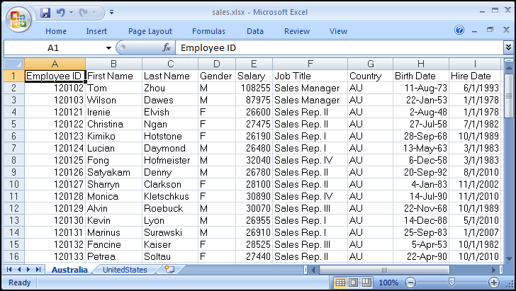
Examining sales.xlsx
embedded spaces in column headings
two worksheets
cells formatted as dates
Notes:
Let’s examine the workbook. Notice the data for each country is on a separate tab. There are 2 date fields, each with a different Excel date format applied.

Slide 7
7.01 Poll
Based on material already discussed, does SAS allow embedded blanks and special characters in variable names?
 Yes
 No
Notes:
Type answer here

Slide 8
7.01 Poll – Correct Answer
Based on material already discussed, does SAS allow embedded blanks and special characters in variable names?
 Yes
 No
SAS variable names
can be 1 to 32 characters long.
must start with a letter or underscore. Subsequent characters can be letters, underscores, or numerals.
can be uppercase, lowercase, or mixed case.
are not case sensitive.
Notes:
Type answer here

Slide 9
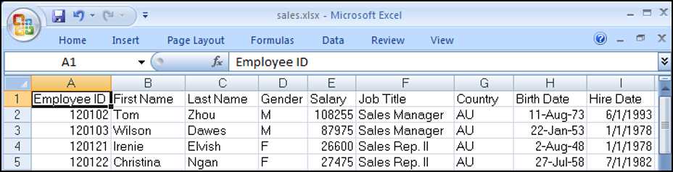
SAS Variable Names
Excel column headings are used as variable names.
The SAS windowing environment replaces blanks and special characters with underscores.
By default, SAS Studio and SAS Enterprise Guide allow blanks and special characters in variable names.
Notes:
In the SAS windowing environment, the VALIDVARNAME= option is set to V7 by default. V7 does not allow variable names to contain special characters.
In SAS Studio and SAS Enterprise Guide, the VALIDVARNAME= option is set to ANY by default. ANY allows variable names to contain special characters. If a variable name contains special characters, the variable name must be expressed as a SAS name literal.

Slide 10
SAS Name Literal
When a variable name contains embedded blanks or special characters, you must use a SAS name literal.
A SAS name literal is a string within quotation marks, followed by the upper or lowercase letter n.
'Job Title'n

Slide 11
VALIDVARNAME= Option
Set the VALIDVARNAME= option to V7 to enforce SAS naming rules in SAS Studio and SAS Enterprise Guide.
options validvarname=V7;
Up to 32 mixed-case alphanumeric characters are allowed.
Names must begin with an alphabetic character or an underscore.
Invalid characters are changed to underscores.
Any column name that is not unique is made unique by appending a counter to the name.

Slide 12
SAS/ACCESS LIBNAME Statement
SAS/ACCESS has multiple LIBNAME engines that access Microsoft Excel workbooks.
 The engine that you use depends on the operating environment of SAS and the bitness of SAS and Excel.
libname orionx excel "&path\sales.xlsx";
libname orionx pcfiles path="&path\sales.xlsx";
libname orionx xlsx "&path\sales.xlsx";
Notes:
Both SAS and Microsoft Office offer 32-bit and 64-bit versions. The term bitness refers to the 32-bit and 64-bit versions of software. To determine the bitness of SAS and Microsoft Office, see the following usage notes:
Installing SAS® 9.3 PC Files Server and using it to convert 32-bit Microsoft Office files to SAS® 64-bit files http://support.sas.com/kb/43/802.html.
Summary of steps to install and use the SAS® 9.4 PC Files Server http://support.sas.com/kb/54/413.html.

Slide 13
SAS/ACCESS Engines
 | EXCEL Engine | PCFILES Engine | XLSX Engine
SAS Operating Environment | Windows | Windows, Linux, and UNIX | Windows, Linux, and UNIX
Bitness | Same | Any combination | Any combination
Additional Software | Yes | Yes | No
Supported Excel File Types | .xls .xlsx | .xls .xlsx | .xlsx
Options | Yes | Yes | Limited

Slide 14
EXCEL Engine
The engine name is optional if an Excel extension is specified.
SAS must be located on Windows.
The EXCEL engine is used when the bitness of SAS matches the bitness of Excel.
This engine uses Microsoft ACE engine (Excel 2007 or later).
It reads .xls and .xlsx file formats.
It allows numerous LIBNAME and data set options.
LIBNAME libref <EXCEL> "workbook-name.ext" <options>;
Notes:
Microsoft Jet (Joint Engine Technology) engine is used instead of Microsoft ACE engine for versions prior to Excel 2007.
The EXCEL engine can also read .xlsb and .xlsm files.

Slide 15
PCFILES Engine
SAS can be located on Windows, Linux, or UNIX.
The PCFILES engine is used with any bitness combination.
This engine requires SERVER= when Linux or UNIX SAS is used.
It uses the Microsoft ACE engine (Excel 2007 or later).
The engine requires the SAS PC Files Server (Windows) in order to connect to the Excel file.
It reads .xls and .xlsx file formats.
It allows numerous LIBNAME and data set options.
LIBNAME libref PCFILES PATH="workbook-name.ext"
<SERVER=Windows server> <options>;
Notes:
SERVER= specifies the name of the Windows computer that is running the SAS PC Files Server. This option is required for Linux and UNIX users to connect to the PC Files Server.
Microsoft Jet (Joint Engine Technology) engine is used instead of Microsoft ACE engine for versions prior to Excel 2007.
The PCFILES engine can also read .xlsb and .xlsm files.

Slide 16
XLSX Engine
The XLSX engine requires SAS 9.4M2 or later.
SAS can be located on Windows, Linux, or UNIX.
This engine is used with any bitness combination.
It accesses the Excel file directly without using the Microsoft ACE engine.
The Excel file must be accessible to Linux or UNIX when you use SAS that is not on Windows.
The engine reads only .xlsx file formats (Excel 2007 or later).
It can read more than 255 columns.
It allows limited LIBNAME options.
LIBNAME libref XLSX "workbook-name.xlsx" <options>;
Notes:
A worksheet in a .xls file can save up to 256 columns and 65,536 rows. Excel 2007 and later files (.xlsx files) have been enhanced to support 16,384 columns and 1,048,576 rows in a worksheet. Files that are created with Excel 2007 and later can have an .xlsx, .xlsb, or .xlsm extension. Due to how the Microsoft ACE driver and the Microsoft Jet driver work, the EXCEL and PCFILES engines are limited to 255 columns in an Excel file.

Slide 17
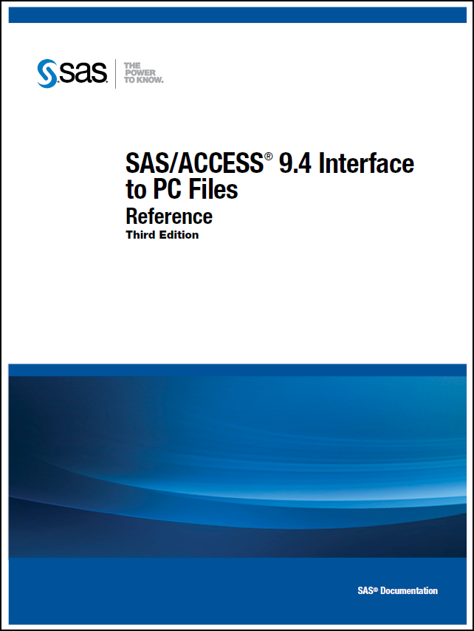
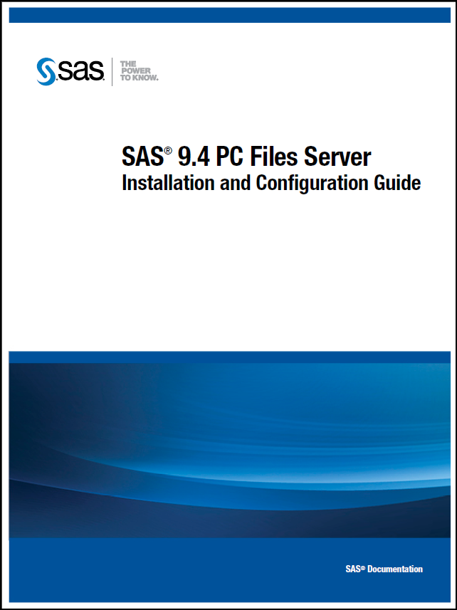
Documentation
For more information about the LIBNAME engines and PC Files Server, refer to the documentation.
http://support.sas.com/documentation/onlinedoc/access/

Slide 18
Exploring the Library
Regardless of the LIBNAME engine that is used, you can use the CONTENTS procedure to explore the library.
When SAS has a libref that is assigned to an Excel workbook, the workbook cannot be opened in Excel.
To disassociate the libref, use a LIBNAME statement with the CLEAR option.
options validvarname=v7;
libname orionx pcfiles path="&path\sales.xlsx";
proc contents data=orionx._all_;
run;
libname orionx clear;
p107d01a
p107d01b

Slide 19
Exploring the Library
Partial PROC CONTENTS Output
 For the EXCEL and PCFILES engines, worksheet names end with a dollar sign.
EXCEL and PCFILES engines
The CONTENTS Procedure
DBMS
Member Member
# Name Type Type
1 Australia$ DATA TABLE
2 UnitedStates$ DATA TABLE
p107d01a

Slide 20
Exploring the Library
Partial PROC CONTENTS Output
 For the XLSX engine, worksheet names do not end with a dollar sign.
XLSX
engine
The CONTENTS Procedure
Member
# Name Type
1 AUSTRALIA DATA
2 UNITEDSTATES DATA
p107d01b

Slide 21
Exploring the Library
Additional PROC CONTENTS Output
 Each engine supplies formats and labels for the Excel data.
# Variable Type Len Format Informat Label
8 Birth_Date Num 8 DATE9. DATE9. Birth Date
7 Country Char 2 $2. $2. Country
1 Employee_ID Num 8 Employee ID
2 First_Name Char 10 $10. $10. First Name
4 Gender Char 1 $1. $1. Gender
9 Hire_Date Num 8 DATE9. DATE9. Hire Date
6 Job_Title Char 14 $14. $14. Job Title
3 Last_Name Char 12 $12. $12. Last Name
5 Salary Num 8 Salary

Slide 22
SAS Name Literal
Because the EXCEL and PCFILES engines refer to worksheets with dollar signs at the end of the names, use a SAS name literal to permit the special character in the worksheet name.
The XLSX engine does not refer to worksheets with a dollar sign at the end of the name, so a SAS name literal is not needed.
orionx.'Australia$'n
SAS name literal
orionx.Australia

Slide 23
Subsetting a Worksheet
Regardless of the LIBNAME engine used, the PRINT procedure can be used to display a subset of the worksheet.
proc print data=orionx.'Australia$'n noobs;
where Job_Title contains 'IV';
var Employee_ID Last_Name
Job_Title Salary;
run;
EXCEL and PCFILES engines
proc print data=orionx.Australia noobs;
where Job_Title contains 'IV';
var Employee_ID Last_Name
Job_Title Salary;
run;
XLSX
engine
p107d02a
p107d02b
Notes:
If the sheet name contains special characters or embedded blanks, a name literal must be used to refer to the sheet, even when using the XLSX engine.

Slide 24
Subsetting a Worksheet
PROC PRINT Output
Employee_
ID Last_Name Job_Title Salary
120125 Hofmeister Sales Rep. IV 32040
120128 Kletschkus Sales Rep. IV 30890
120135 Platts Sales Rep. IV 32490
120159 Phoumirath Sales Rep. IV 30765
120166 Nowd Sales Rep. IV 30660

Slide 25
7.02 Short Answer Poll
You submit the statement below. Which step displays the UnitedStates worksheet?
a.
b.
c.
d.
libname xl excel 's:\workshop\custusau.xlsx';
proc print data=xl.UnitedStates;
run;
proc print data=xl.'UnitedStates';
run;
proc print data=xl.'UnitedStates'n;
run;
proc print data=xl.'UnitedStates$'n;
run;
Notes:
Type answer here

Slide 26
7.02 Short Answer Poll – Correct Answer
You submit the statement below. Which step displays the UnitedStates worksheet?
a.
b.
c.
d.
libname xl excel 's:\workshop\custusau.xlsx';
proc print data=xl.UnitedStates;
run;
proc print data=xl.'UnitedStates';
run;
proc print data=xl.'UnitedStates'n;
run;
proc print data=xl.'UnitedStates$'n;
run;
Notes:
Type answer here

Slide 27






Business Scenario
Create a SAS data set using a Microsoft Excel workbook as input.
sales.xlsx

Slide 28
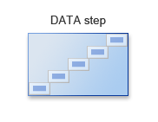



Considerations
Use the SAS/ACCESS LIBNAME engine to read the Australia worksheet and create a temporary data set.
The new data set should include the following:
only the employees with Rep in their job titles
a Bonus variable that is 10% of Salary
permanent labels and formats
Australia
work.subset2
DATA Step
Rep

Slide 29


Creating a SAS Data Set from an Excel Worksheet
This demonstration illustrates reading a Microsoft Excel worksheet to create a SAS data set.
p107d03a
p107d03b

Slide 30


Slide 31
Chapter 7: Reading Spreadsheet and Database Data
7.1 Reading Spreadsheet Data
7.2 Reading Database Data

Slide 32
Objectives
Use a SAS/ACCESS engine to access an Oracle database.
Use an Oracle table as input and create a SAS data set.

Slide 33


Business Scenario
The Northeast Sales Manager requested a report that lists supervisors from New York and New Jersey. The input data is in an Oracle database.

Slide 34
SAS/ACCESS LIBNAME Statement
The SAS/ACCESS LIBNAME statement assigns a libref to a relational database.
This example uses the ORACLE engine that is available in SAS/ACCESS Interface to Oracle.
LIBNAME libref engine <SAS/ACCESS options>;
libref
engine name
libname oa oracle user=edu001 pw=edu001 path=dbmssrv schema=educ;
options
Notes:
Notes: The engine-name such as Oracle or DB2 is the SAS/ACCESS component that reads and writes to your DBMS. The engine name is required.
USER= specifies an optional Oracle user name. USER= must be used with PASSWORD=.
PASSWORD= or PW= option specifies an optional Oracle password that is associated with the Oracle user name.
PATH= specifies the Oracle driver, node, and database. SAS/ACCESS uses the same Oracle path designation that you use to connect to Oracle directly.
SCHEMA= enables you to read database objects, such as tables and views, in the specified schema. If this option is omitted, you will connect to the default schema for your DBMS.

Slide 35
Accessing an Oracle Database
SAS treats the Oracle database as a library, and each table as a SAS data set. Use the CONTENTS procedure to explore the library.
Submit a LIBNAME statement with the CLEAR option to release the database and associated resources.
libname oa oracle user=edu001 pw=edu001 path=dbmssrv schema=educ;
proc contents data=oa._all_;
run;
libname oa clear;

Slide 36
Accessing an Oracle Table
Use a two-level name to reference any table in this Oracle database.
libname oa oracle user=edu001 pw=edu001
path=dbmssrv schema=educ;
proc print data=oa.supervisors;
where state in ('NY' 'NJ');
run;
data work.nysup;
set oa.supervisors;
where state='NY';
run;
libname oa clear;

Slide 37
Viewing the Output
PROC PRINT Output
Obs EMPID STATE JOBCATEGORY
1 1834 NY BC
2 1433 NJ FA
3 1983 NY FA
4 1420 NJ ME
5 1882 NY ME

Slide 38
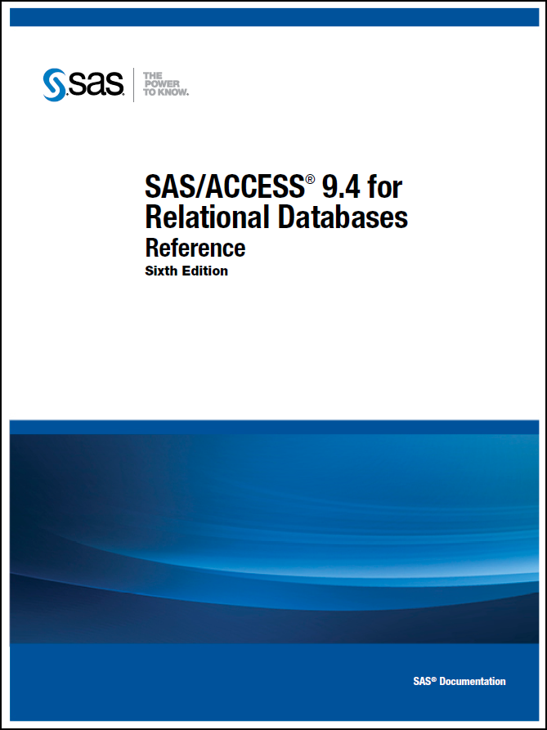
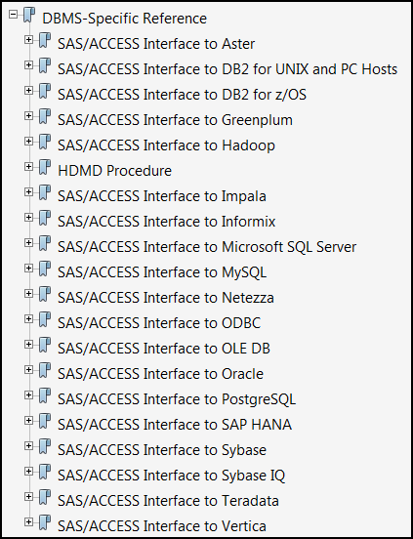
Documentation
Refer to the documentation for information relating to a specific relational database.
http://support.sas.com/documentation/onlinedoc/access/

Slide 40

Notes:
Would like a review of the exercises?
Please answer with your Yes or No seat indicator.

Slide 41
In this SAS/ACCESS LIBNAME statement, what does
oracle represent?
libref
option
table name
engine name
libname sports oracle
user=edu001 pw=edu001
path=dbmssrv schema=educ;
Notes:
Correct answer: d
In this SAS/ACCESS LIBNAME statement, you must specify an engine name following the libref. Oracle is the engine name.

Slide 42
2. Which PROC step successfully prints a list of all data sets in the orionx library without printing descriptor portions for the individual data sets?
proc contents data=orionx.nods _all_;
run;
proc contents data=orionx._all_ nods;
run;
proc print data=orionx._all_ noobs; run;
proc print data=orionx._all_ nods; run;
Notes:
Correct answer: b
A PROC CONTENTS step prints a list of data sets in a library. To suppress the descriptor portions, you specify the following after the DATA= option and the libref: the _ALL_ keyword, a space, and then the NODS option.

Slide 43
3. When you use the SAS/ACCESS LIBNAME statement to assign a libref to a Microsoft Excel workbook, you can view the workbook using Microsoft Excel.
 True
 False
Notes:
Correct answer: False.
If SAS has a libref assigned to an Excel workbook, the workbook cannot be opened in Excel. To disassociate a libref, use a LIBNAME statement and specify the libref and the CLEAR option. SAS disconnects from the data source and closes any resources that are associated with that libref's connection.

Slide 44
4. When you use the SAS/ACCESS LIBNAME statement to assign a libref to a Microsoft Excel workbook, SAS treats each worksheet within the workbook as a library.
 True
 False
Notes:
Correct answer: False
SAS treats the workbook as a library, and each worksheet as a SAS data set.

Slide 45
5. What does the program shown here create?
a data set named sales.qtr1_2011 and a data set named sales.qtr2_2011
an Excel workbook named sales.qtr1_2011 and an Excel workbook named sales.qtr2_2011
an Excel workbook named annual that contains two worksheets, qtr1_2011 and qtr2_2011
an Excel workbook named sales that contains two worksheets, qtr1_2011 and qtr2_2011
libname sales excel 'c:\mydata\annual.xls';
data sales.qtr1_2011;
set sasdata.qtr1_2011;
run;
data sales.qtr2_2011;
set sasdata.qtr2_2011;
run;
Notes:
Correct answer: c
This program creates one Excel workbook named annual that contains two worksheets, and it uses two data sets as input data.

Slide 46
6. What statement is used to read an Oracle table in a DATA step?
DATA statement
WHERE statement
SET statement
assignment statement
Notes:
Correct Answer: c
A SET statement reads observations from a SAS data set for further processing in the DATA step.

Slide 47
7. A SAS name literal is a string that contains one or more special characters, enclosed in quotation marks, followed by the letter n.
 True
 False
Notes:
True
A SAS name literal is a string within quotation marks, followed by the letter n. SAS name literals permit special characters in data set names.

Slide 48
8. When a date value is read from a worksheet, it is converted automatically to a SAS date. Which SAS format is used to display the value?
MMDDYY8.
MMDDYY10.
DATE7.
DATE9.
Notes:
d.
The DATE9. format is used to display all dates read from a worksheet regardless of how the date was formatted in the worksheet.

Slide 49
9. When a SAS data set is created from a spreadsheet, the spreadsheet column headings are always stored as which of the following?
variable names
labels
formats
descriptor
Notes:
B
The original column headings are stored as labels in the descriptor portion of the new data set. In SAS Enterprise Guide, the column names are also used as variable names, but this is not true in the SAS windowing environment.

Slide 50
10. A WHERE statement or a subsetting IF can be used to subset a Microsoft Excel worksheet.
 True
 False
Notes:
True
You can use a WHERE statement or a subsetting IF statement to process a subset of a worksheet because the worksheet is treated as though it were a SAS data set.

